Slide 1
Theory Of Automata
Project : Tennis Game
Shahrukh Khan 2010330
Aitizaz Khan 2010036

Slide 2
Introduction
Scope of this project is to implement tennis game scoring system using Automata Theory
This Project was Implemented using java as the main programming language
Various java functions used during implementation were
i) Draw (for GUI)
ii) Action Listener
iii)repaint etc

Slide 3
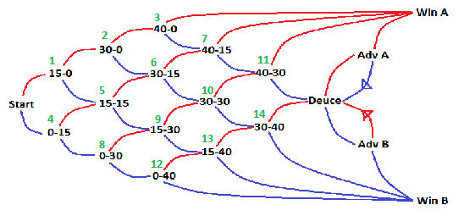
Automata

Slide 4
Automata Cont.
The figure was edited to facilitate understanding of the implementation
As the game progresses, it was attempted to draw the automata dynamically.

Slide 5
Thank you

